Slide 1
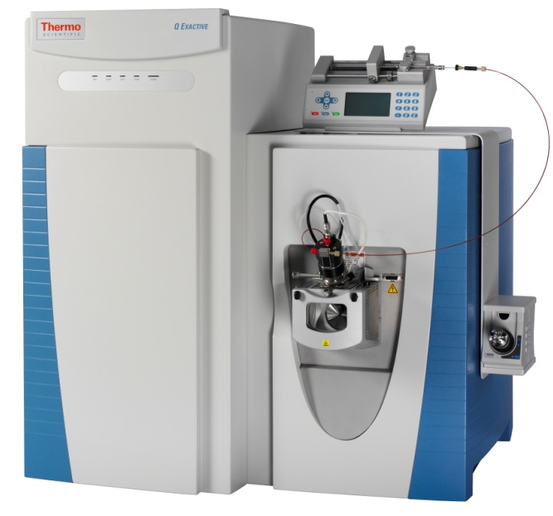
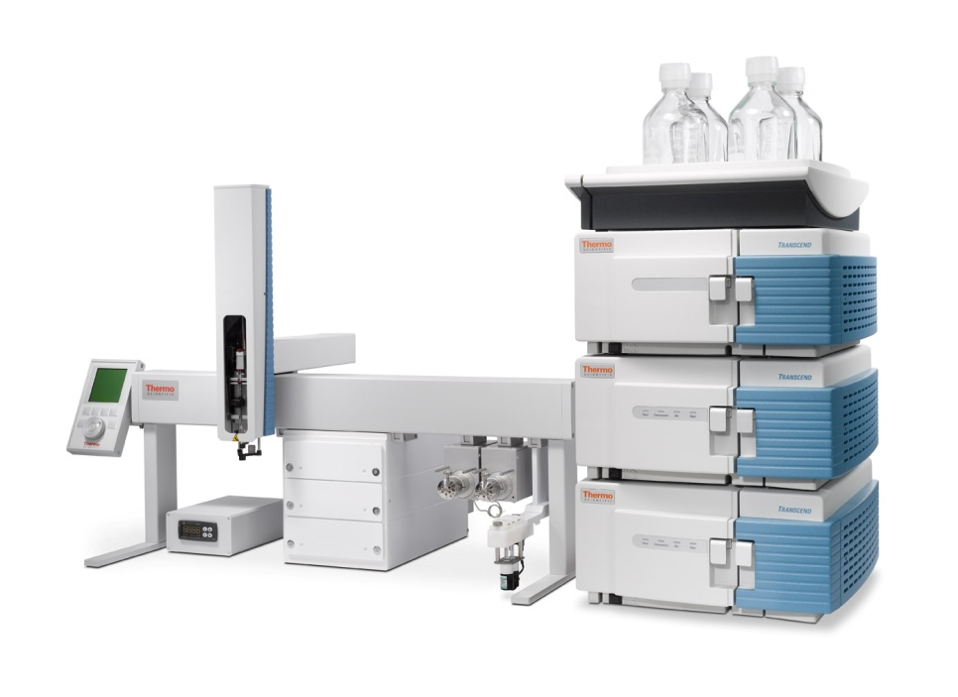

Q-Exactive LC-MS

Slide 2
TurboFlow technology
Special columns
Complex valving
Extra pump
UHPLC
Fast separation
Best separation

Slide 3
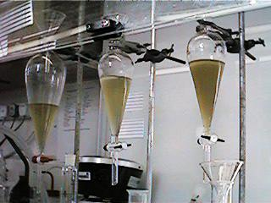
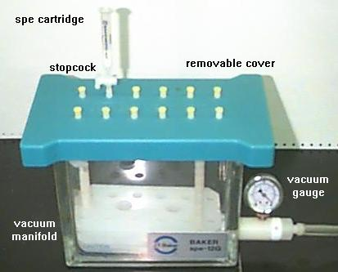
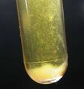
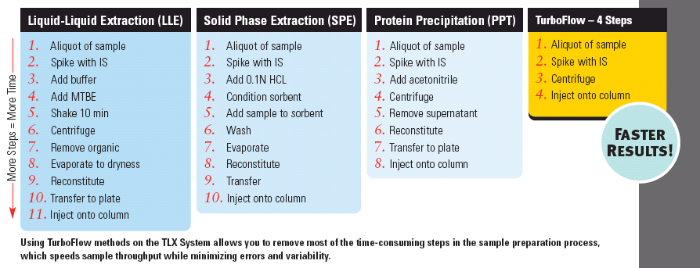

fewer sample prep steps with TurboFlow technology

Slide 4

Why TurboFlow columns are different: Duality
Bimodal Separation on One Column
Size Exclusion
Turbulence within column
Velocity faster than diffusion on large molecules
Chemistry
C18
C8
Ion Exchange
Cyclone P
Cyclone
12 different types
For targeted analyses, not profiling - yet
Notes:
What is duality? Size exclusion chromatography and Chemistry. Based on the fact that small molecules diffuse into the pores faster than large particles. And running at high velocity the large MW diffuse slower and therefore are swept out of the column before they diffuse into the pore. Where the small molecules diffuse much faster and have the ability to go into the pores. So Turbulent Flow chromatography allows under these conditions is column technology which superior selectivity based on using 2 modes of separation rather than one. We have better selectivity over other sample prep methods.
Biomodal separation size exclusion and chemistry in one column. This is what makes TurboFlow columns so different from typical HPLC columns.

Slide 5

Turboflow column

Slide 6
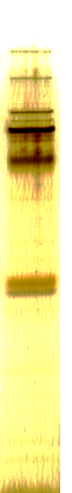

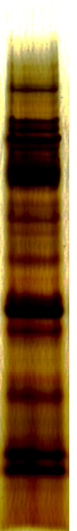

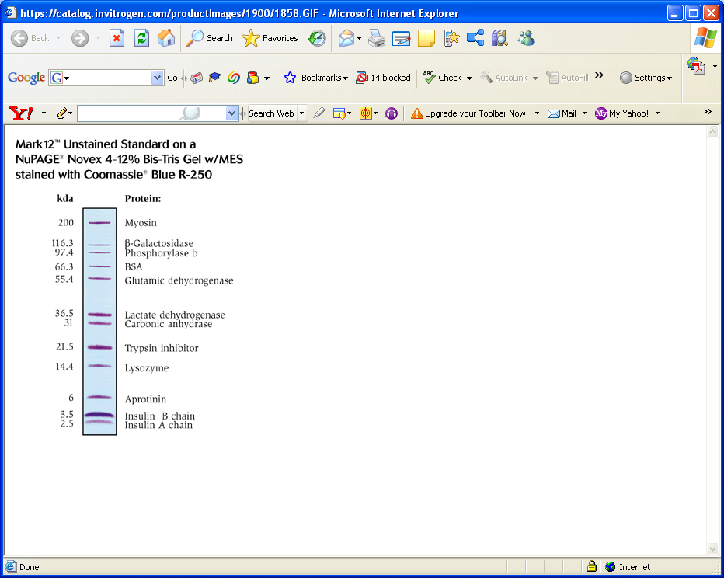
Cleaner Plasma Extracts
A 10,000-fold dilution of . matrix
B TurboFlow Method
C Generic SPE
D Protein Precipitation
1 mm, 4-12% Bis-Tris gel
20 μL applied
Equivalent matrix amounts applied
A
B
C
D

Slide 7

Tetracycline at 500 pg/ml with TLX vs HPLC in Pig Liver Matrix
HPLC
TLX
TLX Sample shows removal of interference compared to standard HPLC!
Courtesy of Dr. Charles Yang

Slide 8

Leuco Malachite Green at 50pg/ml in Pig Liver
HPLC vs TLX turboflow
HPLC
TLX
Aria TLX Sample shows improved S/N and removal of chemical noise!
Courtesy of Dr. Charles Yang

Slide 9

Reduce Ion Suppression Effects
SPE, PPT and TurboFlow method comparison
Rat Plasma
A
B
Buffered H20
TLX System
With TurboFlow method
has less ion suppression
than other 2 methods
c
PPT
4:1 MeOH/H20
SPE
50:50 MeOH:H20
[J. L. Herman, Cephalon, Inc., Brandywine Parkway, PA]
Notes:
Ion Suppression

Slide 10
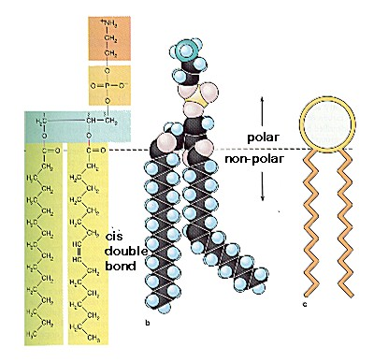
Phospholipids – ion suppression
Ubiquitous (all species)
Concentrated (mg/ml in plasma)
Relatively late-eluting
Surfactants –“matrix effectors”
Strongly retained (ghost peaks)
Unstable –degrade to fatty acids and head groups
Ref: K. C. Van Horn, Tandem Labs, BSAT Presentation 2006

Slide 11

1000 Times Less Phospholipid
10⁶
10⁶
A: PPT
B: direct TurboFlow method
10³
Sample precipitation enhances extraction of endogenous phospholipids
Direct injection of plasma results in a 1000-fold reduction in phospholipid signal

Slide 12
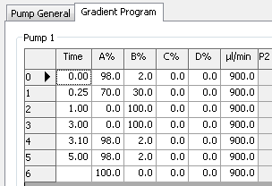
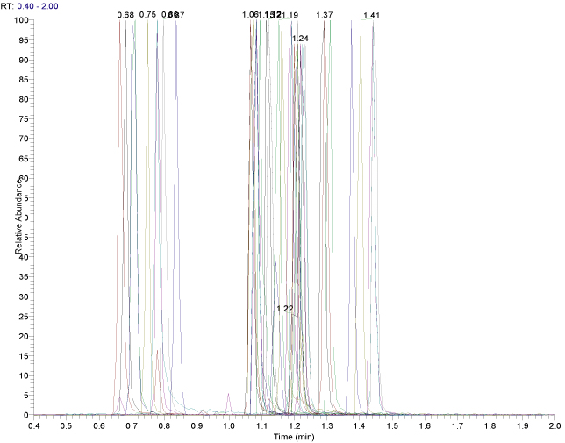
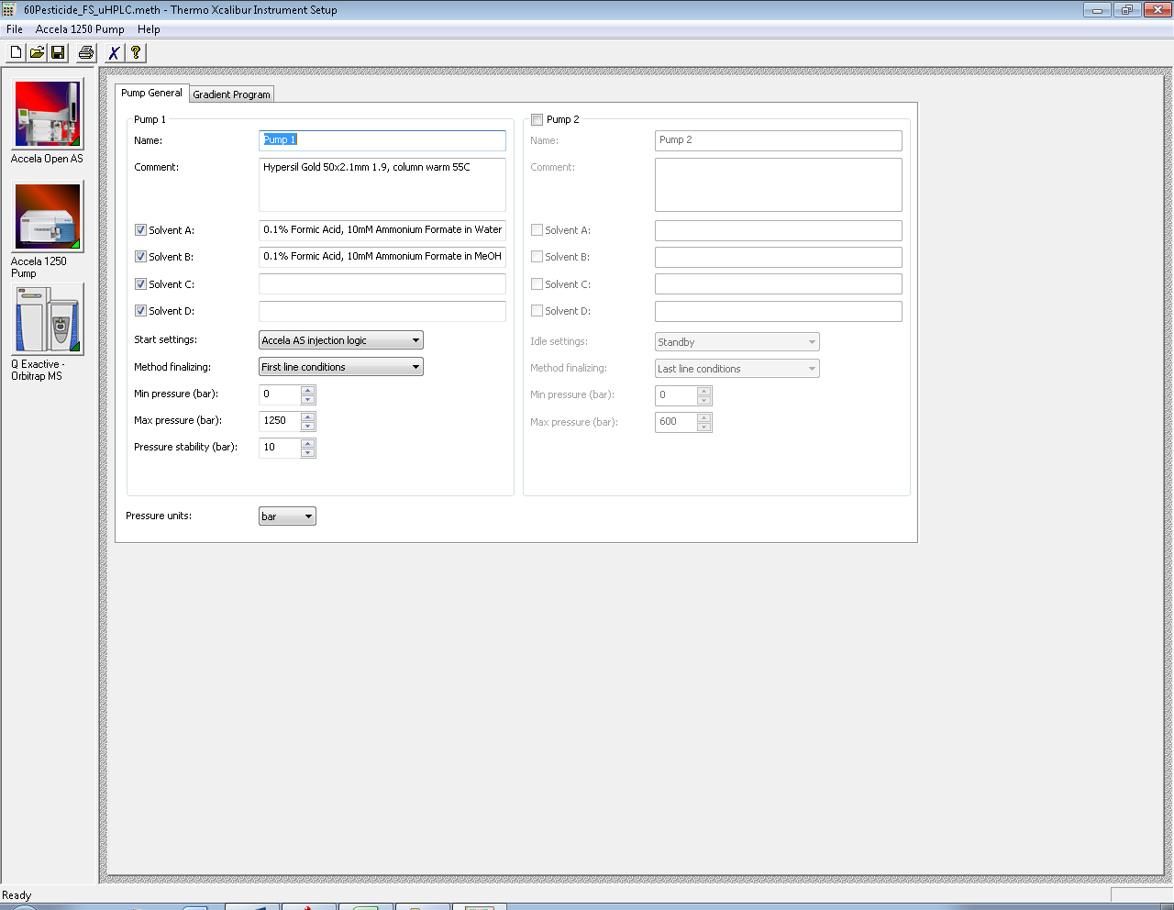

UHPLC: 60+ pesticides in 2 mins, 4s wide peaks, Full scan
Accela 1250 + Q Exactive
R = 70,000
All compound elute in 2mins, with peak width of 0.04 mins = 9 scans under the peak

Slide 13
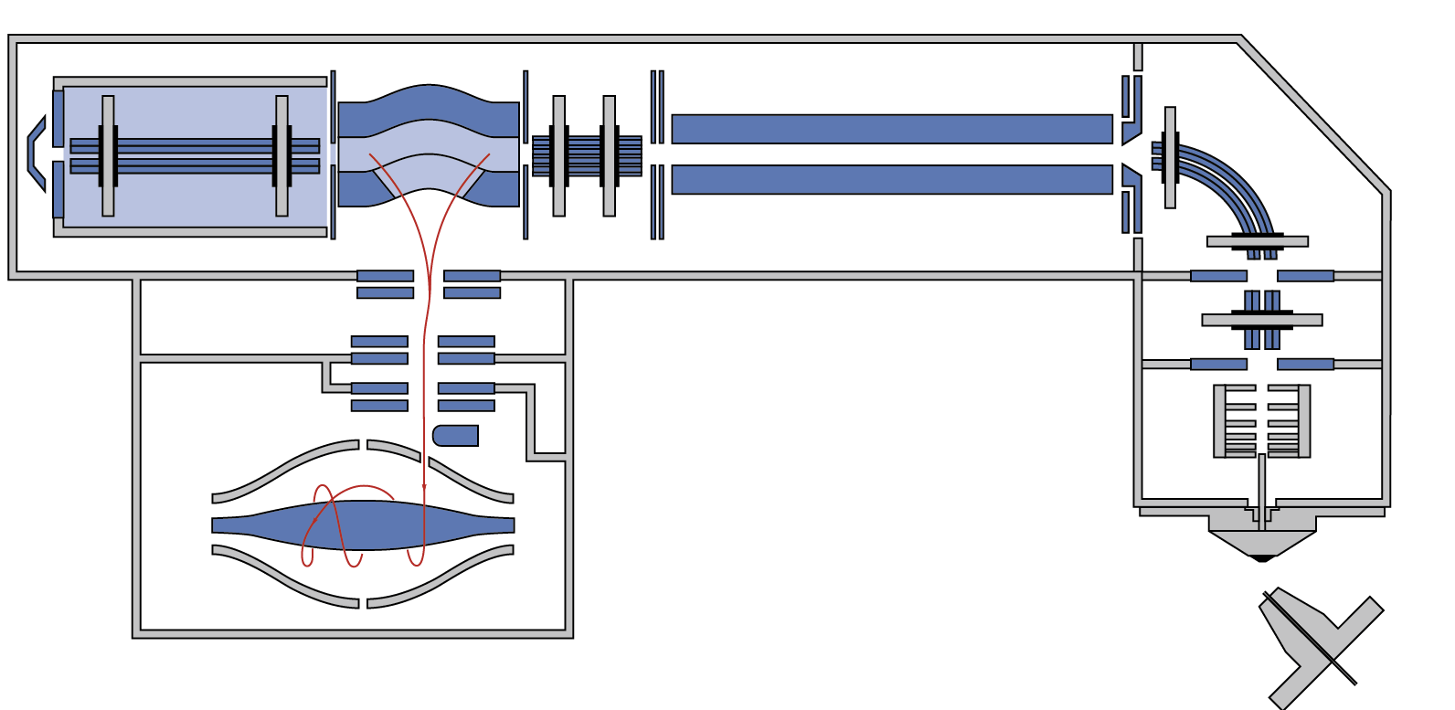
Instrumentation: Q Exactive
HCD Collision Cell
C-trap Spectrum Multiplexing
Quadrupole Mass Filter
S-lens
Orbitrap Enhanced FT

Slide 14
Q-Exactive specs
Mass Resolution – up to 140,000 @ m/z 200
  Scan speed decreases with resolution
  Up to 70,000 Res. at UHPLC speeds
  Resolution decreases as mass increases
  Very high resolution for small molecule analyses
Mass accuracy < 5 ppm; usually < 2 ppm
  With external calibration
Mass range 50 – 6000 m/z
Scan speed – 12,000 amu / second
Sensitivity in ppt range
Dynamic range 1 - 5000

Slide 15
SIM
Signal visibility is dependent on whether a signal is visible above the spectrum noise
Spectrum noise is dependent on the ratio of compound within a certain ion population
195.0876
100
N=248402.81
NL: 1.94E8
Gain in sensitivity (7x)
Full MS
[150.00-2000.00]
Lowest detected
signal/scan
250330
80
60
S/N = 745
40
20
0
195.0877
100
N=20741.58
NL: 1.12E8
80
[190.10-200.10]
60
SIM (10amu)
Lowest detected
signal/scan
28240
Relative Abundance
40
S/N = 5400
20
0
Caffeine
Sensitivity gain 5 – 10 x with SIM mode

Slide 16

Long-term Mass Accuracy with External Calibration
Realistic conditions of an average lab
Temperature variations up to 3°C peak-to-peak, up to 1°C/hour
3° C
Notes:
Here has to pointed out that proven mass accuracy can be expected.
Nevertheless we spec 5 ppm for external calibration and 1 ppm for internal cal.
Mass calibration is within the specs for 24 h.
Temperature compensation is working fine.

Slide 17
Q Exactive – functions
Function | What for? | Information
Full scan Positive or negative ions | Qualitative screening Quantitation | Accurate mass
SIM | Quantitation of knowns | Very low concentration
In-source CID | Qualitative screening Quantitation | Accurate mass with extra confirmation and structure information.
CID + MS² | MS³ structure info. | Accurate mass with extra confirmation and structure information.
MS² in HCD cell; All Ions Fragmentation, Data Dependent or targeted like QQQ | Qualitative screening Quantitation | Accurate mass with extra confirmation and structure information.

Slide 18



Target or Non-Target analysis workflow
SAMPLE
Target Analysis
Non-Target Analysis
?
Target screening
Profiling
Fingerprinting
Authenticity
Identification
Quantitation
Quantitation
Triple Quad
Q-Exactive
HR/AM

Slide 19
Metabolomics analyses possibilities
Metabolomics
  A comprehensive analysis of all metabolites
  A measure of the fingerprint of biochemical perturbations – pattern recognition
  Useful when you don’t know what to expect
    Hypothesis generation
Targeted Analysis
  Metabolite target analysis
    E.g. Analysis restricted to metabolites of
    an specific enzyme system that is known
    to be affected by a certain perturbation
  Metabolite profiling
    E.g. Analysis focused on a class of compounds
    associated with a particular pathway
  Only find what you are looking for

Slide 20
Anatomy of a UHPLC + Orbitrap Data Set
m/z window = ± 1 Da
5
852.9720
853.4727
100
[M+H]⁺
z =+2
853.9745
>1,000,000 data points
~100,000 extracted ion peaks
Peak area ranges ~ 7 orders
Much irrelevant data
Much redundant data
High quality data from the Orbitrap allows for more precise automated data processing
854.4817
0
853.0
853.5
854.0
854.5
855.0
m/z
0
100
200
300
400
500
600
700
800
900
1000
+2
+3
≥+4
+1
Need to be able to reduce the data to chemical entities
Notes:
Removing chemical noise

Slide 21
Software for Q Exactive
Xcalibur for data acquisition & initial processing
SIEVE for handling large LC-MS data sets; differential analysis, trend evaluation; discovery
ExactFinder for searching external data bases; unknown screening & routine targeted analysis
MetWorks for metabolic samples; searches for biotransformations
Mass Frontier for structural elucidation
Proteome Discoverer for proteomics data; qualitative & quantitative
ToxID for automated screening for known compounds
Notes:
Expecting Metworks shipping in July

Slide 22
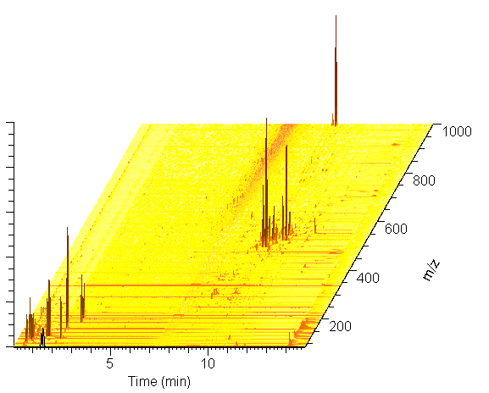
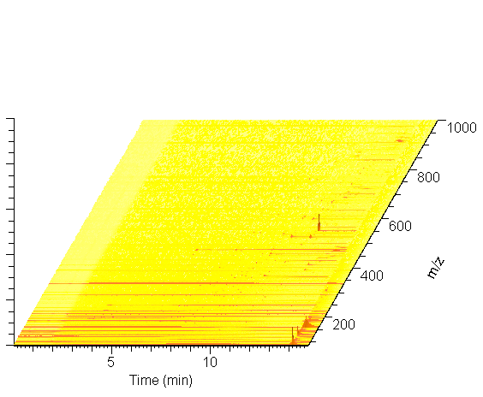
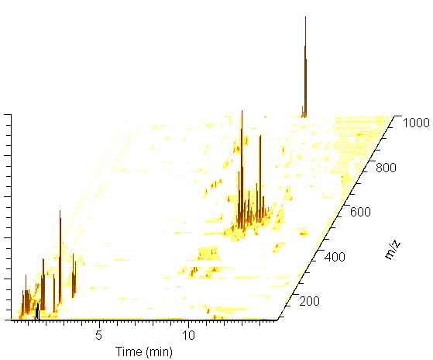
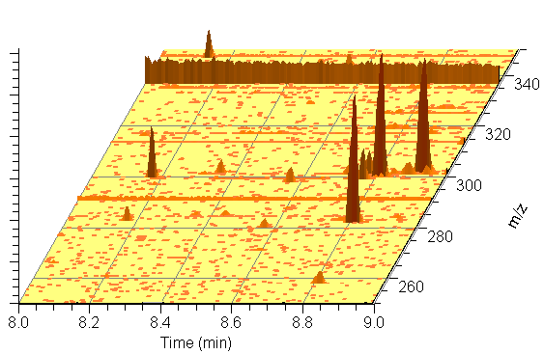
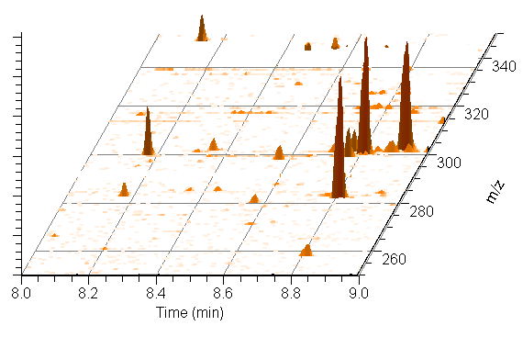
Chemical: Background Subtraction
Sample
- Solvent blank
= Analyte signals
~98% of lower intensity signals are eliminated
Notes:
Removing chemical noise

Slide 23
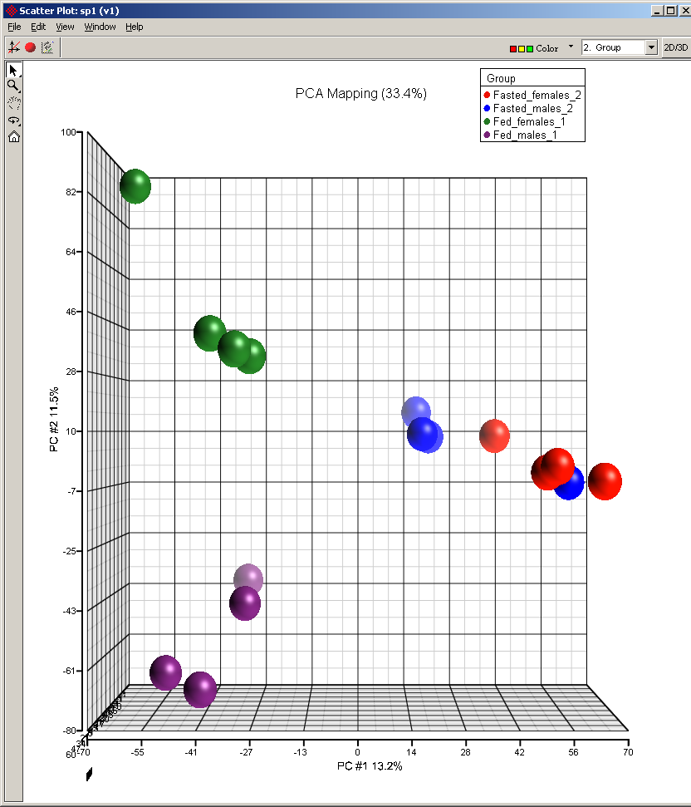
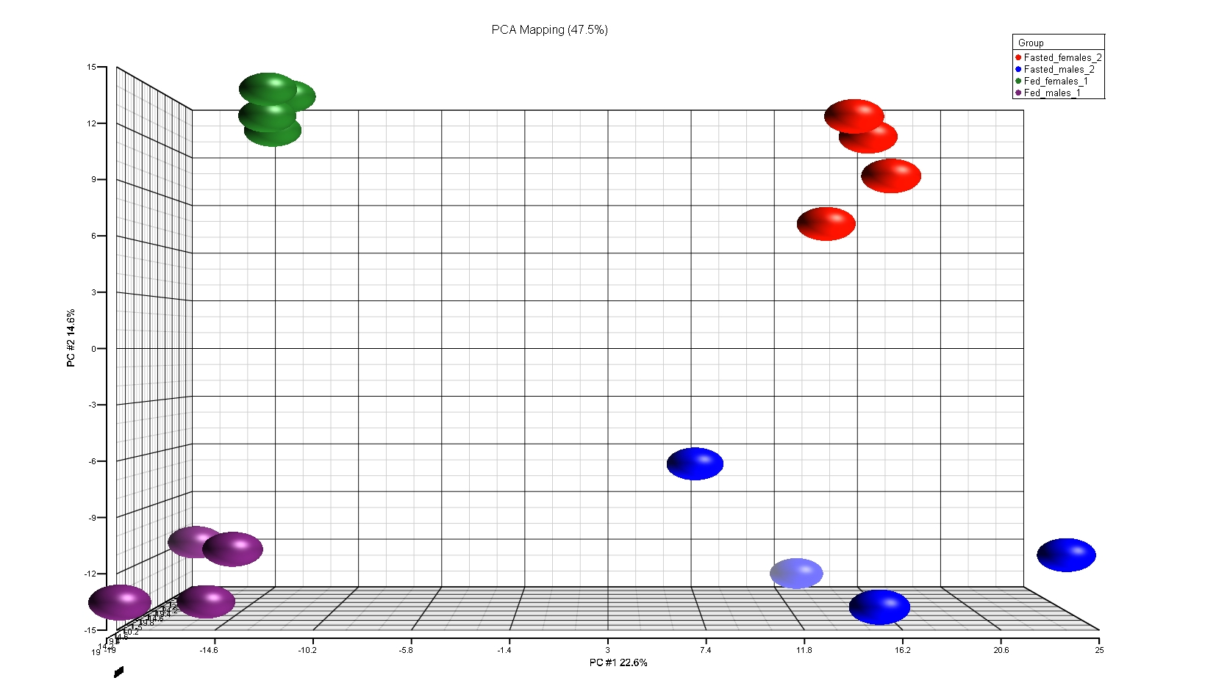
SIEVE: Removing Noise from Statistics
Components
m/z Peaks
Fed
Fasted
Increased intra group variability
Female
Loss of group separation
Male
Notes:
Clear distinction between groups once noise is removed

Slide 24
Q-Exactive
UHPLC – ultimate separation
TurboFlow - targeted analyses in bio matrices with little prep
Accurate mass, very stable, MS/MS
Margaret Coe
m.coe@auckland.ac.nz

