Slide 1
Genomics – Next-Gen sequencing and Microarrays
Overview
By Tim Lawrence

Slide 2
Genomics Lab Team
Liam Williams
Tim Lawrence

Slide 3
Accessing our services
Next-generation sequencing and microarray work is contracted through NZGL
These services are not able to be booked in iLab
But our other equipment is bookable in iLab!

Slide 4
What we offer (assistance)
A start to finish collaborative approach to assisting with your next-generation sequencing and microarray projects!
Project planning advice
In conjunction with the Bioinformatics Institute team
Individualised training in using methods/equipment

Slide 5
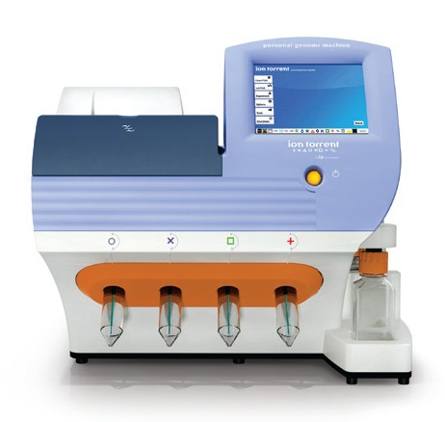
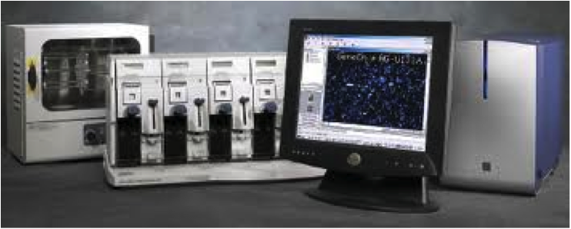
Our equipment platforms
Illumina MiSeq sequencer
Life Technologies Ion Torrent PGM sequencer
Affymetrix microarray wash station and scanner

Slide 6
Sequencing types: Sanger vs next-gen
Sanger (capillary)
Long reads
Single samples
Confirmation of next-gen results
Next-gen
High throughput
Multiplexed samples
Short reads
Large data output

Slide 7
Common sample types
Genomic DNA
Amplicons (PCR products)
RNA
Small RNA / microRNA

Slide 8
What we offer (services)
Library preparation for all platforms (including elsewhere via NZGL/overseas)
Sequencing on MiSeq and PGM
Sample labelling, hybridisation and scanning for Affymetrix microarrays

Slide 9
What is a library?
Essentially:
Preparing a library = getting nucleic acids into the form required by the next-gen sequencer
Making it the right size
Adding adapters
Adding multiplex “barcodes”

Slide 10
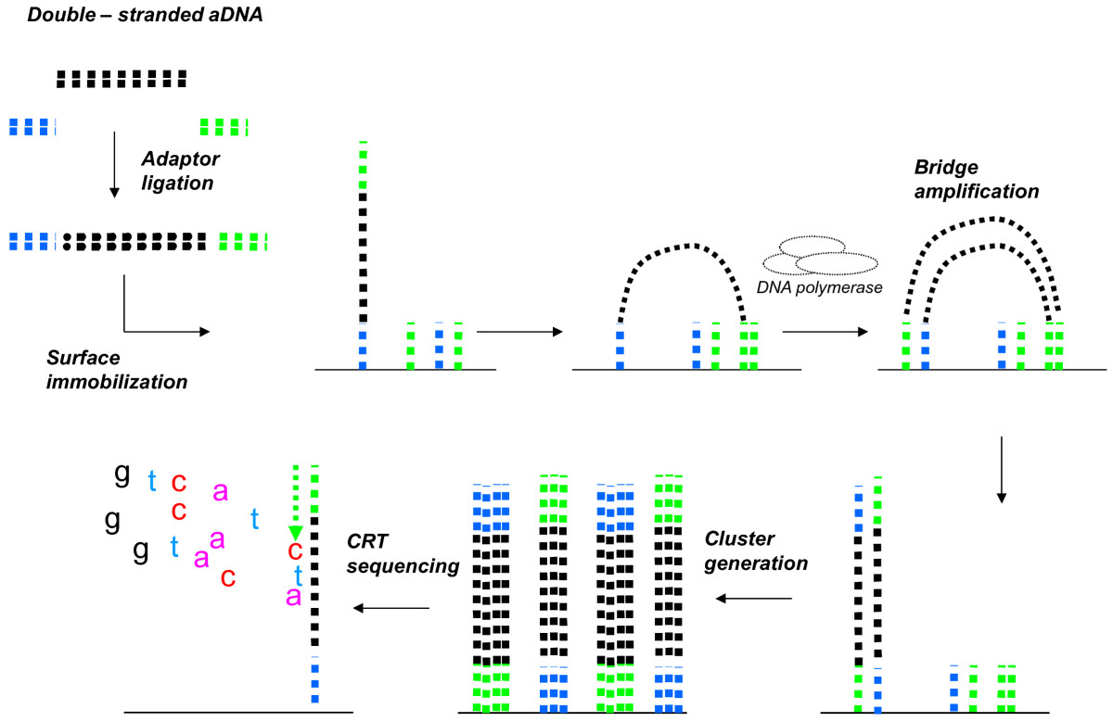
How does NGS work? (Illumina method)
Figure from gsejournal.org

Slide 11
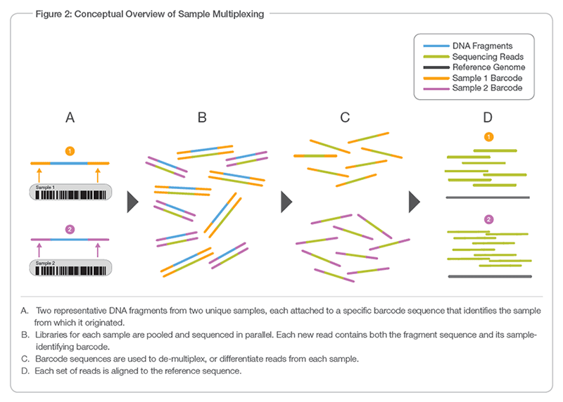
Multiplexing or “barcoding” samples
Figure from Illumina

Slide 12
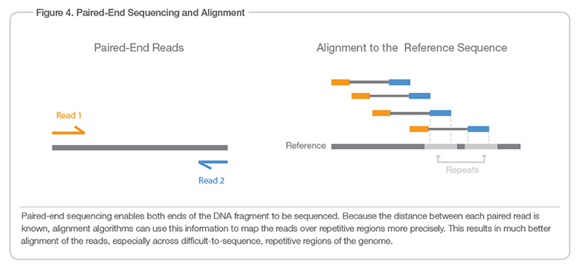
Paired-end sequencing
Figure from Illumina

Slide 13
Capabilities: Ion Torrent PGM
DNA or RNA
100,000 – 5 Million reads
200 – 400 bp reads
Fast run time
Premade amplicon panels
Custom panels

Slide 14
Common project types – PGM amplicon panels
Comprehensive Cancer Panel
Inherited disease
Community panels
Ion Ampliseq Designer
Custom Panels <5 Mb, <6144 amplicons

Slide 15
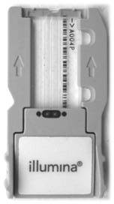
Capabilities: Illumina MiSeq
DNA or RNA
10 Million-20 Million reads
50 bp – 300 bp Paired end reads
1-2 day run time
Whole Genome sequencing of small genomes
Amplicon sequencing
smallRNA

Slide 16
Common project types - MiSeq
Identification of bacteria in complex samples
Uses PCR to amplify 16S rRNA
We do PCR addition of adapters and barcodes
MiSeq run 2x250bp or 2x300bp
Sequencing small genomes
We use specialised library prep kits optimised for your samples
MiSeq run 2x250bp or 2x300bp

Slide 17
MiSeq - Amplicon Preparation
High quality DNA
Accurate input quantification
Complete removal of primer
Balanced read numbers across samples
Mock community controls are available
Up to 384 samples per run
2-step PCR protocol allows any amplicon to be sequenced up to 500 bp

Slide 18
MiSeq - Small Genomes
Up to 18 Bacterial Genomes per MiSeq run
High molecular weight gDNA
Sheared with Covaris m220 to 350 bp – 550 bp
Adapters and barcodes added by ligation
Optional PCR enrichment

Slide 19
Next-gen Sample Prep Tips
High Quality
High Molecular weight genomic DNA
Clean Amplicons (use AMPureXP)
Intact totalRNA
RIN ≥ 7 if possible
Exceptions
FFPE kits
Specialised kits for low input and degraded samples

Slide 20
Supporting equipment – QC/quant
Bioanalyzer
DNA/RNA sizing, quantity and quality
Qubit fluorimeter
DNA and RNA fluorometric quantification
NanoDrop spectrophotometer
DNA and RNA spectrophotometric quantification
Bookable on iLab

Slide 21
Supporting equipment
Covaris M220 sonicator
DNA fragmentation
Robotic workstations: Biomek 4000, Eppendorf epMotion
High-throughput liquid handling
Bookable on iLab

Slide 22
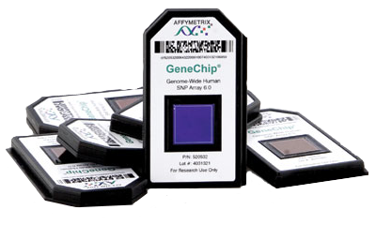
Capabilities: Affymetrix microarrays
Gene expression (RNA or small RNA)
Defined probesets
Reproducible datasets
Total RNA input
Transcriptome Analysis Console (TAC) software

Slide 23
Affymetrix – Gene expression
PrimeView
530,000 probes, 36,000 transcripts
MiRNA v4.0
30,000 probe sets

Slide 24
Which platform is best?
Each platform has pros and cons
Discuss with us about which best suits your experimental outcomes
We work closely with the Bioinformatics Institute who can advise on experimental design

