Slide 1
Vicky Fan
Bioinformatics Institute
Bioinformatics services

Slide 2
What is Bioinformatics?
“Bioinformatics is both an umbrella term for the body of biological studies that use computer programming as part of their methodology, as well as a reference to specific analysis "pipelines" that are repeatedly used, particularly in the fields of genetics and genomics.” Wikipedia.
Biological data analysis using a computer.
Notes:
Really don’t like the term ‘pipelines’

Slide 3
What isn’t (typically) bioinformatics?
Statistics (although we do use some)
Pathway analysis (Mia will talk about this later)
Programming (some)
System administration
Fixing your printer

Slide 4
Bioinformatics services to help your research
Training and workshops – Introductory and specific applications
Experimental design
Grant writing assistance including collaborations
Individual or group ‘coaching’ assistance – helping you work with your own data
Quality assessment of data from any source
Analysis of any dataset
Notes:
Experiment-based (e.g., RNA-seq, expression microarrays, re-sequencing etc.)
Project-based (e.g., simulation, annotation, network reconstruction etc.)

Slide 5
Why is our focus on collaborative experimental design so valuable?
Number of samples
Coverage
Reference genome
Platform type
We want to make sure that what is planned will answer your questions of interest
Notes:
Extreme case: n=2, t=2. We want to help you to answer your questions.
Will you have enough sequence to detect what you want to see? Trying to do variant detection, but it’s not common, or rare transcript detection.
Do I have enough microarrays for my experiment?
Suppose you want to compare something or map to a reference genome, is that genome any good?
Is the platform that you have in mind suitable for your needs? Sequencing a bacterial genome on MiSeq – OK, human, no way

Slide 6
Data analysis
I would like to analyse my data myself, but need some help
We can run tailored workshops
We provide whatever assistance you need
I just need somewhere to analyse my data
Please analyse my data for me
Notes:
I don’t really know what I’m doing, or would like to analyse the data myself. Please teach me/run a workshop. Lets analyse the data together, or look over my shoulder while I do this.
I know what I need to do, just that standard uni supplied box doesn’t quite cut it
Take it away!!

Slide 7
My data
We don’t really mind where your data comes from
NZGL
Macrogen
BGI
But data transfer is easier with NZGL projects

Slide 8
I need somewhere to analyse my data
NZGL’s Bio-IT is a modest computing environment designed for bioinformatics analysis
Secure access and data backup
Pre-installed software suits your needs, or install your own
Use up to 6 compute nodes, each with 16 cores and 96GB of RAM
“Big Mem” VM with 500GB RAM and 16 CPUs
Notes:
Secure, and backed up. NZGL data put onto this system by default, so a bonus!
default your workspace is configured with 32GB of RAM and 4 CPU cores, but you have full access to the high performance computing platform which consists of 6 compute nodes, each with 16 cores and 96GB of RAM
Need more RAM? we also have large memory resources (500GB, 16 CPUs) which you can buy access to for a required period of time

Slide 9
Please analyse my data for me
RNA seq
Microarrays
Annotation of data
A lot of things
Quality assessment of data
Notes:
Very important to make sure you have good quality data before you really do anything. Garbage in garbage out.
NZGL generated data incudes this step as part of genomics
We’ve come across fastq files from a specific sequencing provider that seemed to be missing lines

Slide 10
Dan Jones
Bioinformatics Institute
Case studies:
A standard RNAseq / differential expression experiment
Non-standard examination of degraded RNA

Slide 11
Case study 1:
RNAseq and differential expression
What is the status of the reference genome?
Coverage? Completeness?
Accuracy of gene predictions? Prediction of non-genic features?
Who published it? Are there likely to be further revisions? Is it available for use?
Is it the same breed/strain/cultivar/cell line as the system you are working with?
What is an appropriate experimental design?
Can you get enough RNA? Is the tissue recalcitrant? Are some RNA extraction methods likely to result in biases? Is DNA contamination going to be a problem? What is known about the transcriptome in these tissues? Do you have particular genes of interest and is the design going to detect them? Are you interested in mRNA, small RNAs, or all RNA? Are you using appropriate controls?
An example of a fairly standard experimental design
Known reference genome: Eukaryotic model system
Two tissue types / two conditions
The biological question: at the level of the transcriptome..
What is the difference between the tissue types?
What effect does the treatment have?
What outcomes do you want?
Do you simply want a list of differentially expressed genes? Do you want to investigate co-expression of genes? Effects of promotors? Which isoforms are dominant? Do you want in-depth investigation of a particular gene, set of genes, pathway?
How are you going to interact with your results? Do you have a genome browser set up? Do you want to allow time for investigation of unusual or unexpected results?

Slide 12
Case study 1:
experimental design
RNA extraction method was determined to be appropriate; however, we added ERCC spike-in controls
Literature review of similar studies in this tissue/system allowed us to determine an appropriate volume of sequencing on the HiSeq platform
Similarly, the likely variability of the transcriptome was assessed in a literature review: this has implications for the appropriate number of biological repeats
Total RNA kits were used; client was not specifically interested in small / ncRNA but wanted this data available
Numerous errors were discovered in one publicly available source of the reference genome: it turned out that this site wasn’t being maintained. We spotted the errors and switched to another source.

Slide 13
Case study 1:
The process
The Process
Where we added value
RNA extraction
NZGL supplies and adds ERCC spike-in controls
Total RNA library generation + multiplexing
Stringent QC of the library preparation process
HiSeq sequencing
Stringent QC and quality trimming of the data
Data delivery, storage, backup (remote access)
Demultiplexing + Quality control
Bioinformatics

Slide 14
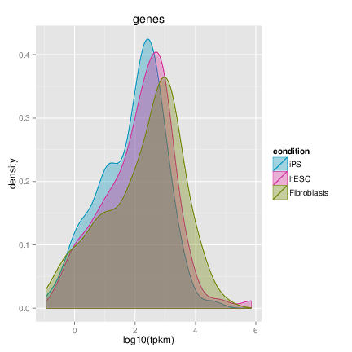
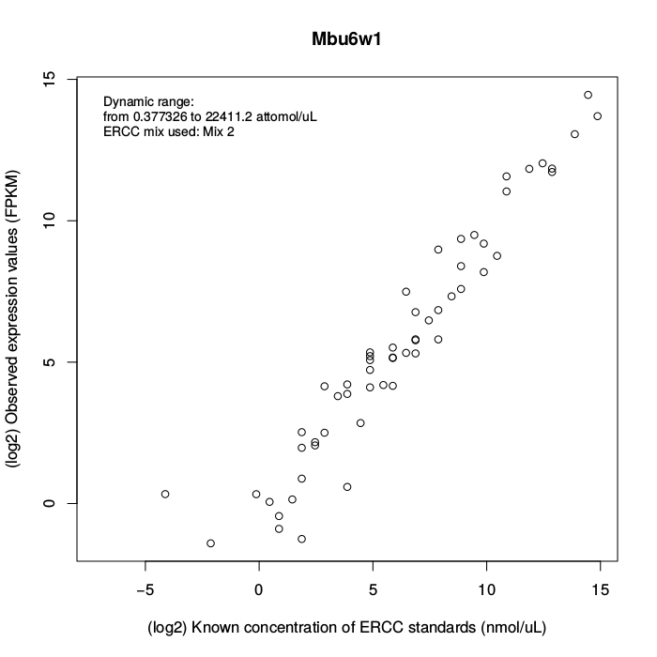
The Process
Where we added value
NZGL Bioinformaticians have published the SolexaQA package; one of the most commonly used QC tools for NGS data. (New version out!!)
Preprocessing + quality trimming
Ongoing “sanity checks”: Checking the right reference genome is used. Checking the right gene predictions are used.
Allowing downstream analysis of ERCC spike-in controls.
Mapping of reads to reference genome
Ongoing “sanity checks”:
Are biological repeats behaving as expected?
What is the distribution of transcript lengths? Abundances? What are the implications?
Are controls behaving as expected?
Differential expression analysis
Functional enrichment / pathway analysis
Case study 1: Bioinformatics

Slide 15
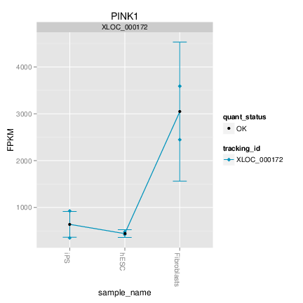
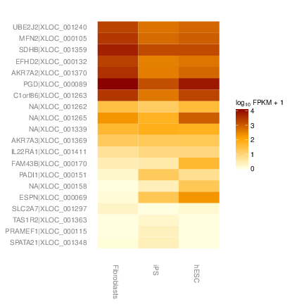
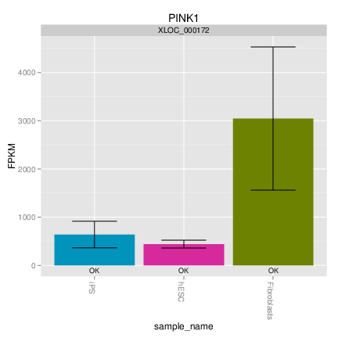
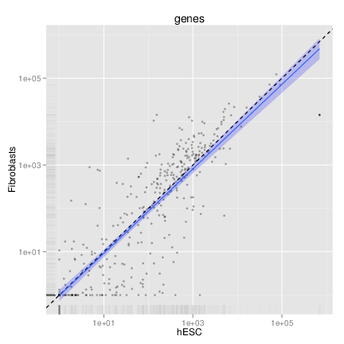
The Process
Where we added value
Preprocessing + quality trimming
Mapping of reads to reference genome
Whole-transcriptome level analyses
Analysis of individual genes, sets of genes, isoforms, “shared promotor” genes
Publication-quality plots and graphics
Differential expression analysis
Functional enrichment / pathway analysis

Slide 16
Now how can we help with your projects?

