Slide 1
TITLE HERE
Name here
Affiliation here
www.psych.auckland.ac.nz/uoa/NZAVS
Acknowledgements: This research was supported by a Templeton World Charity Foundation Grant (ID: 0077) and a RSNZ Marsden Grant (ID: VUW1321).

Slide 2
Title
Note that a more complete power point presentation with a series of slides with detailed information is also available on the NZAVS website, see technical document e22.

Slide 3
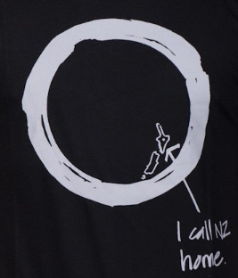
New Zealand
Small nation of 4.5 million
WEIRD nation
Formally bicultural, with indigenous population (Maori) about 15% of the population
Also multicultural, with immigration from Asia, Pacific and Europe.
Asian peoples 12%,
Pacific 7-8%
Referred to by some as the ‘most oversampled nation’
Image from Carvin Steetwear – NZ – Federation. http://www.carvinstreetwear.com/brands/federation/federation-i-call-new-zealand-home-2.html

Slide 4
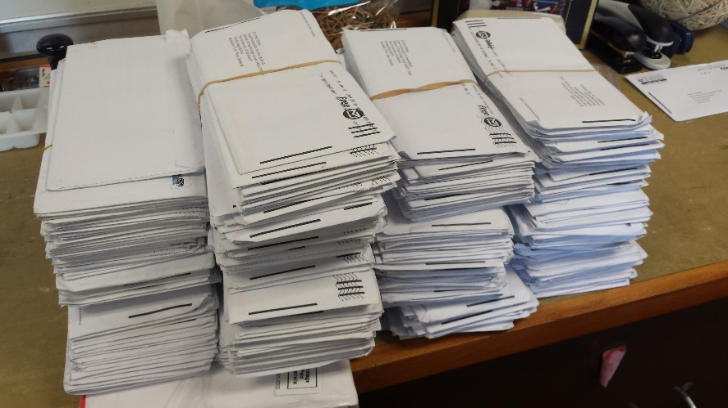
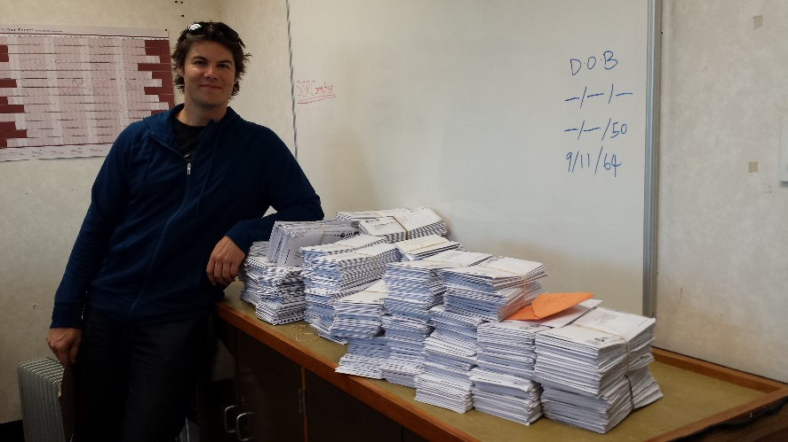
What is the NZAVS?
Planned 20-year longitudinal study
Focus on personality, social attitudes, values, identity, wellbeing and health outcomes.
Something uniquely New Zealand.
Currently in its 8th year
Postal survey
Sample frame drawn from NZ Electoral Roll
Sample contains about 22,000 unique people
Large multidisciplinary research team
Generated more than 90 published papers
Wave-to-wave retention about 80%
The daily mail (random day)
The daily mail during a busy period of data collection.

Slide 5
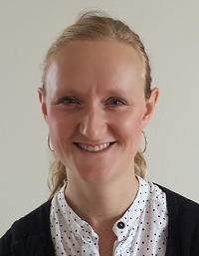
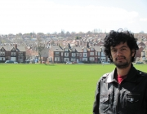
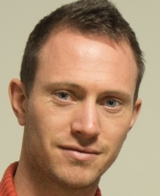
The NZAVS Research Team
www.psych.auckland.ac.nz/uoa/NZAVS

