Slide 1
Raising teacher expectations, changing beliefs and enhancing student achievement
Workshop 3

Slide 2
Workshop 3: Classroom climate
Welcome
Questions/ queries
Feedback from surveys
Outline of the day’s programme

Slide 3
Plan for the day
9.05: Review of last workshop
9.45: Classroom climate: general evidence
10.30: Morning tea
11.00: Classroom climate and teacher expectations
11.30: Measuring the class climate
11.45: Positive psychology and the evidence
12.30: Lunch
1.00: Applying the principles in your classroom
1.30: Planning for change

Slide 4
Review of last workshop
Teaching resource
  Ideas you might use
Action plan
Did you try anything new?
If so, how did it go?

Slide 5
Classroom climate
What do we mean by the classroom climate?
Classroom society is central for students
The classroom as a society
  Involuntary participation and continuous coercion are the foundations of school culture
  Try to create a positive learning atmosphere

Slide 6
Classroom climate: some evidence
Students, engagement and the class climate
Class climate and a mastery goal orientation
Teacher warmth

Slide 7
Classroom climate: non-verbal behaviour
Affect displays
Display rules
Deception and detection
Lies and liars

Slide 8
Non-verbal leakage
Control of non-verbal channels
Separation of non-verbal channels
Detecting concealment
  The leakage hierarchy
Daily interactions

Slide 9
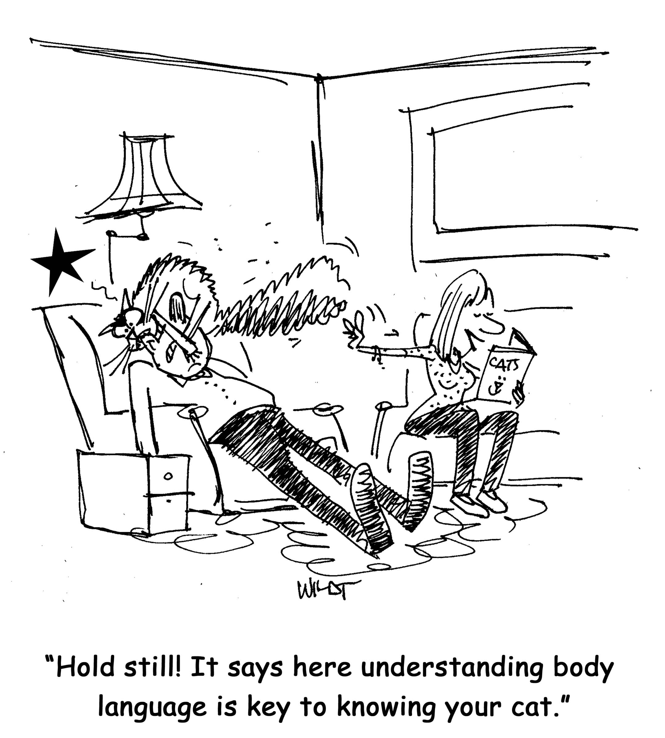

Slide 10
Teacher expectation evidence
An accumulation of evidence
An empathy for the students

Slide 11
Rhona Weinstein
The classroom community
  Competition vs cooperation
  Put downs
  Public exchanges
  Frequent group changes
  Involving parents/ grandparents

Slide 12
New Zealand research
Self-perception of students with high and low expectation teachers
Salience of ability
Student choice
Goal setting
Mastery goal orientation
Students working together
Questioning and responses
Behaviour management
  Preventive: What lovely quiet girls over there and these boys here as well
  Reactive: Ah, that red table, you’re remembering your quiet voices

Slide 13
Teacher traits
Teacher efficacy
Teacher warmth
Teacher expectations
Culturally responsive teachers

Slide 14
What is my class climate like?
Measuring relationships
Measuring the class climate

Slide 15
The social structure of the classroom
Learning about social structures
The classroom society

Slide 16
Classroom narrative
Teacher understandings
Efforts to understand the narratives and social world of classrooms
The implicit world

Slide 17
Sociometric measurement
Sociometry
Attractions and rejections
Teacher use of sociometric measurement
Quantifying the nominations
Teacher understanding

Slide 18
Ann
Sue
Jill
Mary
Rose
Sonia
Alice
Diane
Beth
Carol
Gayle
Lyn
Aroha
Janet
Sara
Kuini
Millie
Lizzie

Slide 19
Analysis of classroom structure
Stars
Isolates/ rejected students
Dyadic friendships
Cross-gender selections
Leaders
Cliques
Individual student

Slide 20
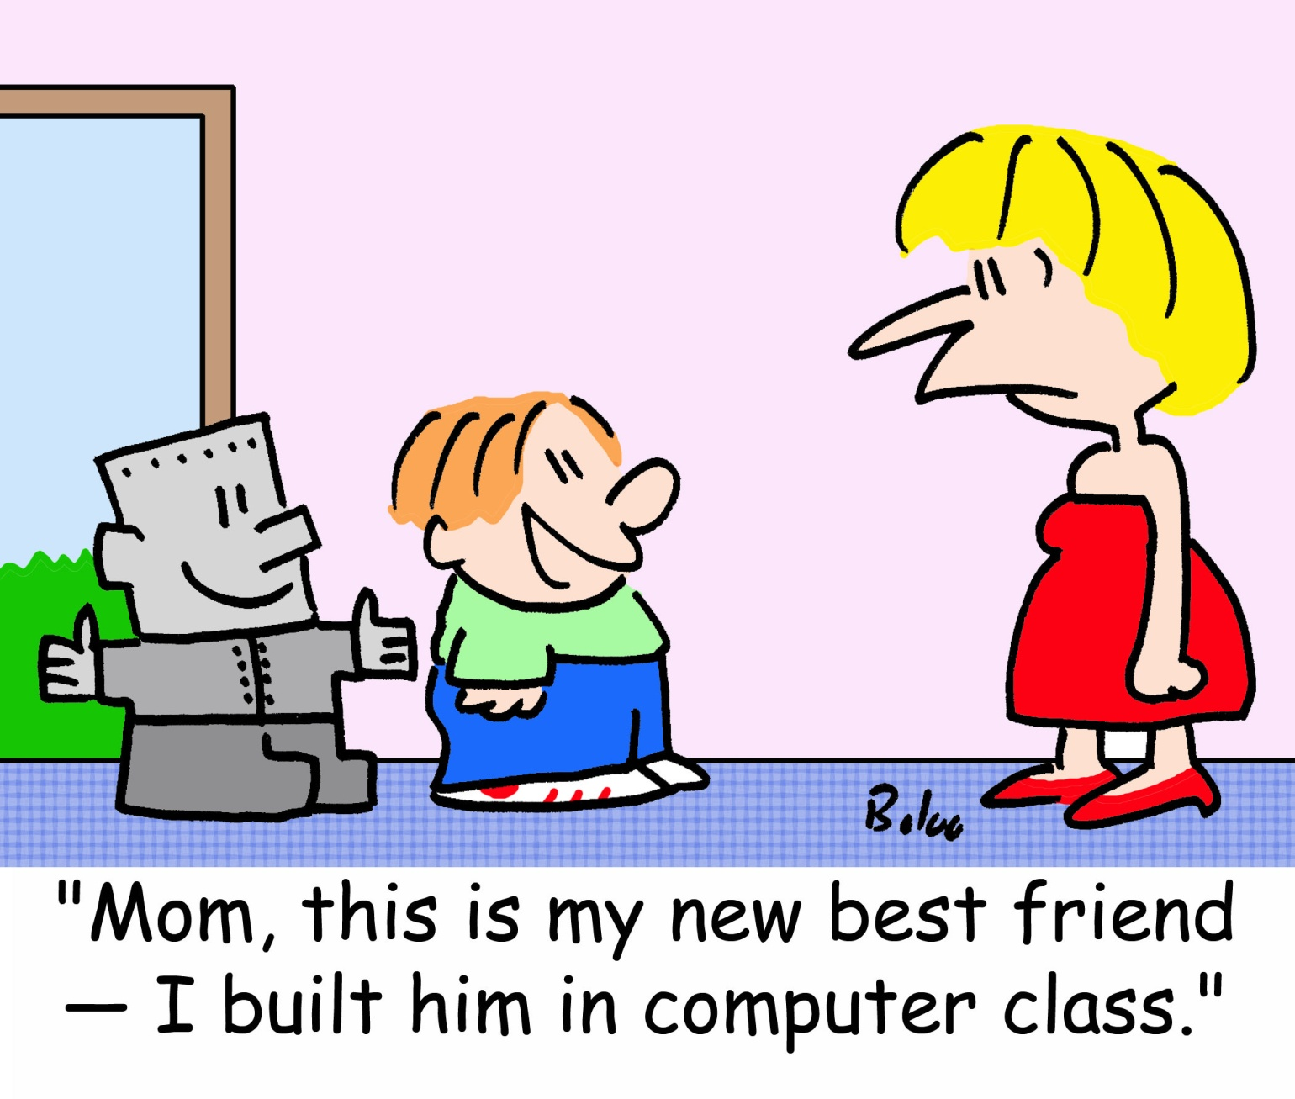

Slide 21
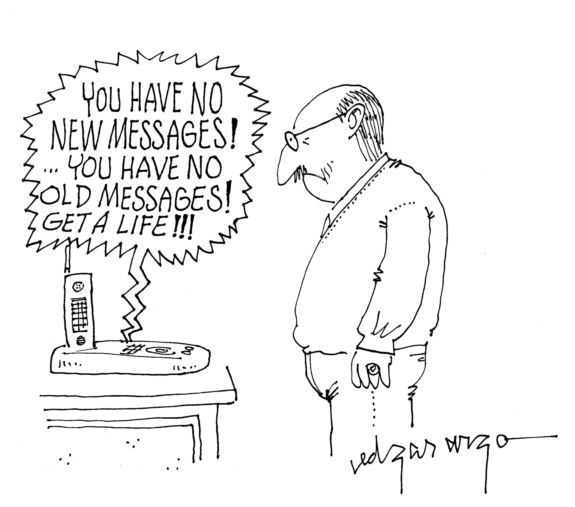

Slide 22
Measuring the class climate
What is the class climate?
How can we assess the class climate?

Slide 23
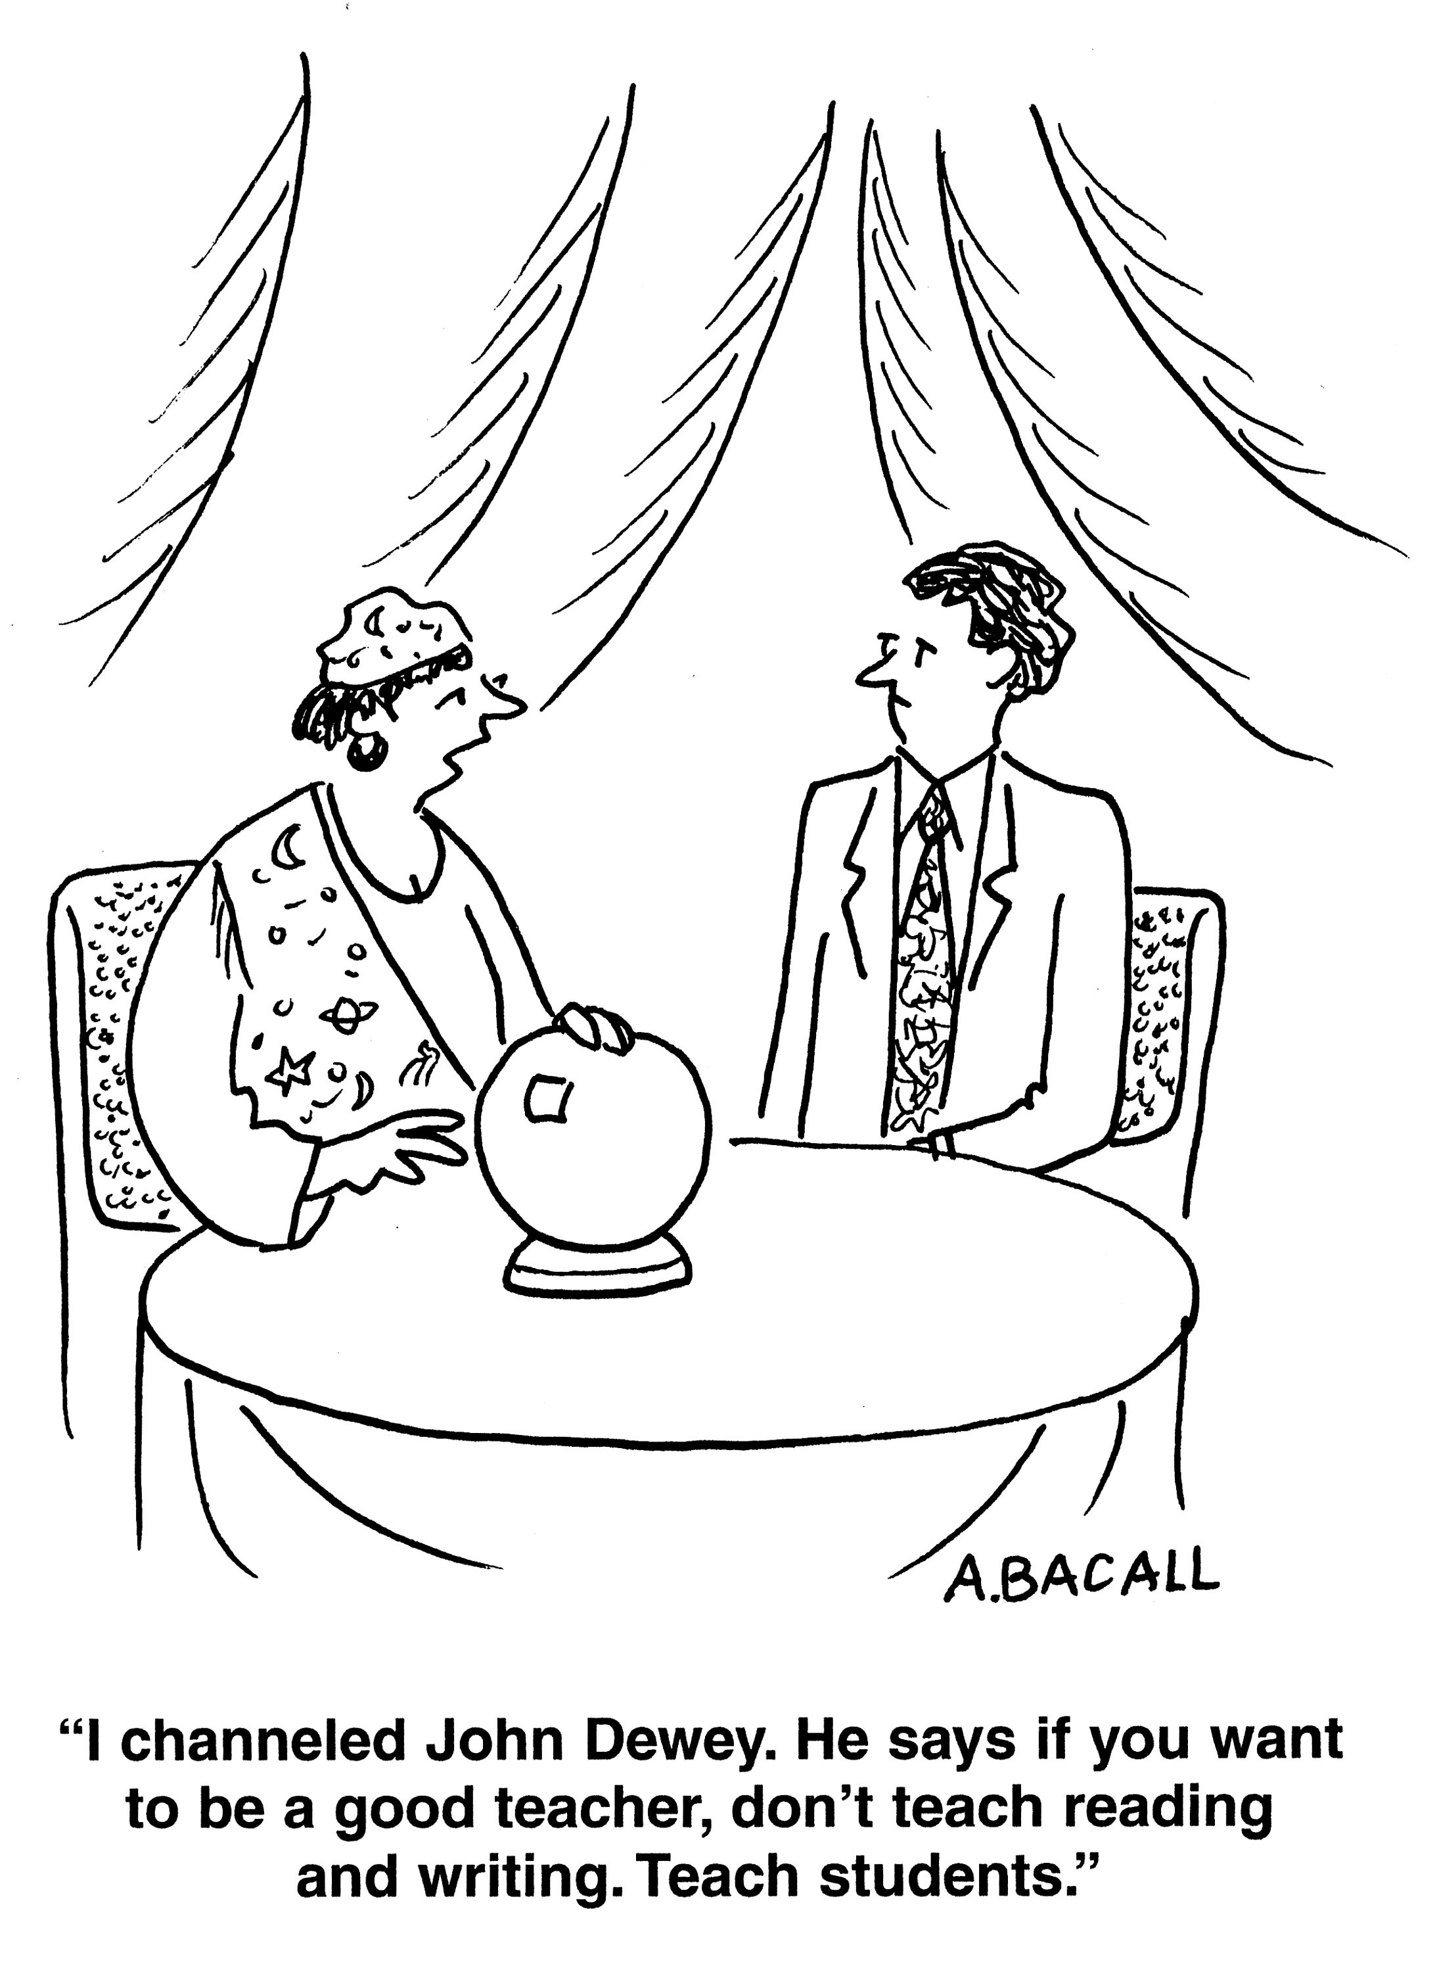

Slide 24
The My Class Inventory
Satisfaction
Friction
Competitiveness
Difficulty
Cohesiveness

Slide 25
Bringing it together: Positive psychology
www.positiveemotions.org
http://www.centreforconfidence.co.uk/pp/positive-psychology.php
http://www.teachingexpertise.com/articles/implementing-positive-psychology-3700
http://www.sal.hut.fi/aaltosystemsforum/positivity/

Slide 26
Positive emotions
Joy
Gratitude
Serenity
Interest
Hope
Pride
Amusement
Inspiration
Awe
Love

Slide 27
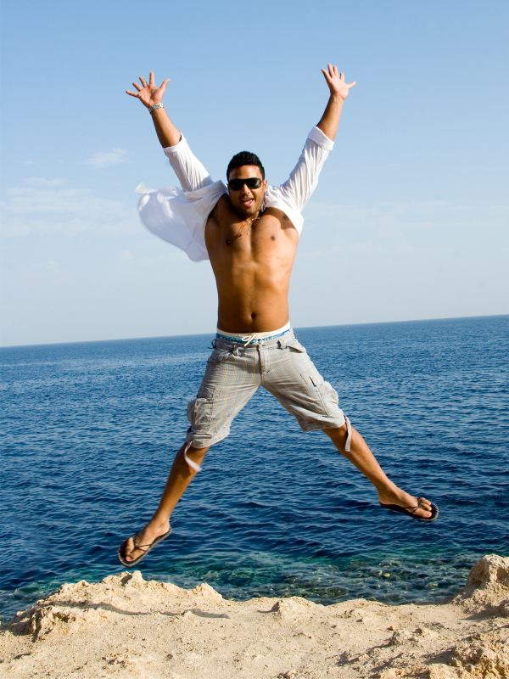
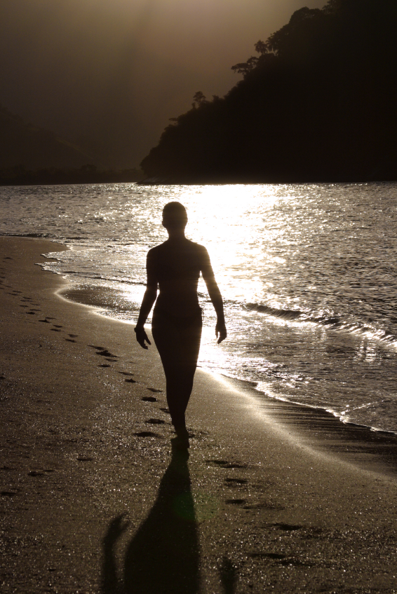
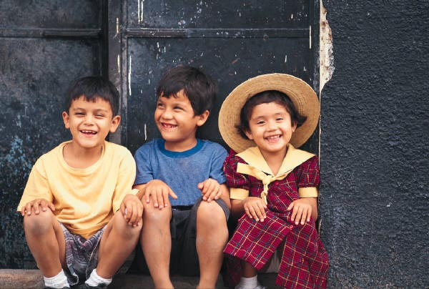
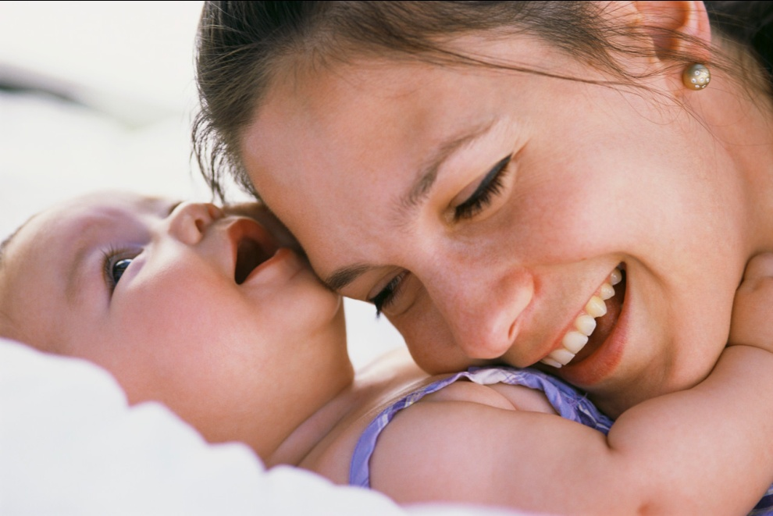

Slide 28
Global vs Visual Processing

Slide 29
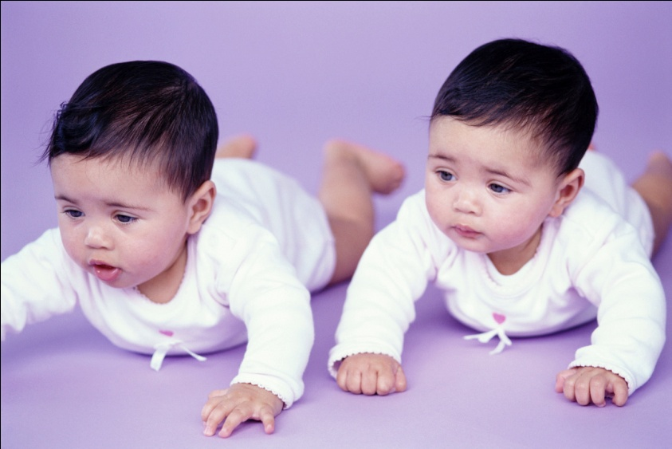
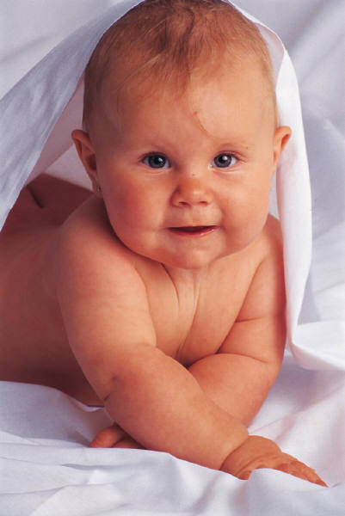
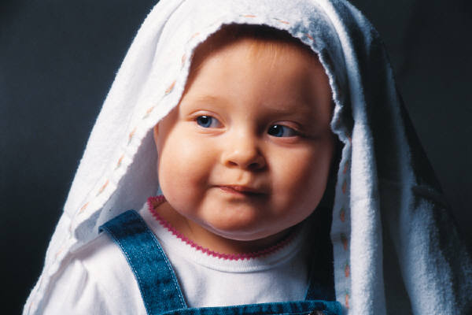
Eye tracking

Slide 30
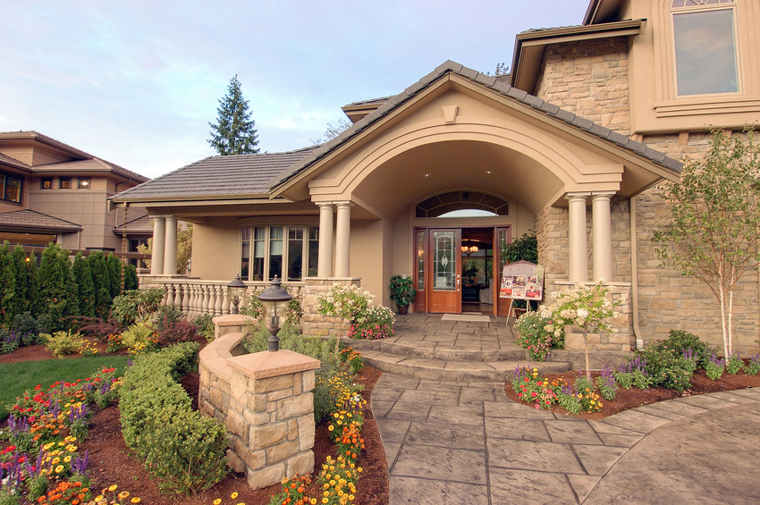
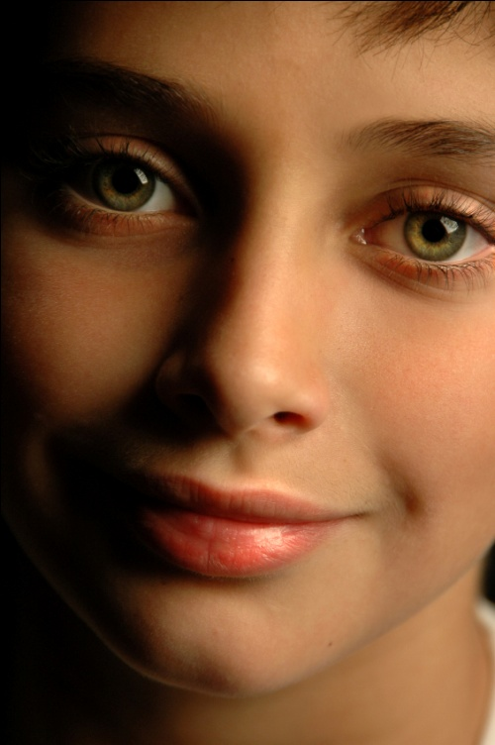

Slide 31


Slide 32
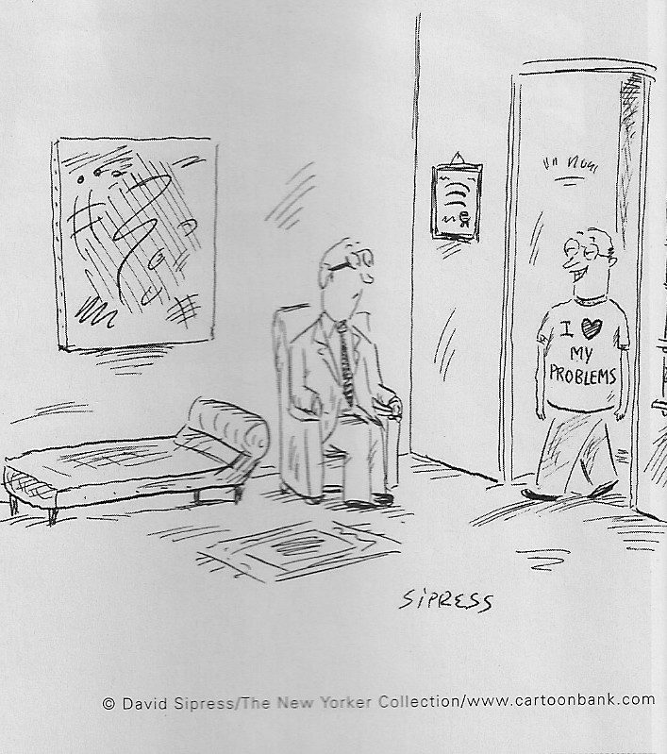
Positivity transforms us

Slide 33
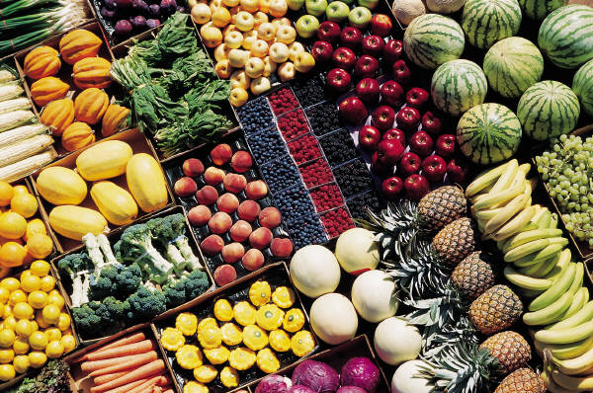
Increasing our daily diet

Slide 34
Positivity transforms relationships
Thanker expresses appreciation
Benefactor perceives partner responsiveness
Feels good about the self and the relationship
Long-term benefits

Slide 35
Create the mindset of positivity
Positivity ratio – 3 to 1
Be open
Be appreciative
Be curious
Be kind
Be real

Slide 36
Implementing the ideas
Instruction and management
  Cooperation
  Quality of interactions
  Non-verbal behaviours
  Group changes
  Preventive management
  Response to questioning
  Creating a classroom community
  Involving parents

Slide 37
Implementing the ideas: planning for change
Do something as a class every day
Discussion/ follow-up activity: What’s really great about being in this class? What’s the best time you have had in this class? What was happening? How could we make it like that all the time?
Counting kindness: recording the times people are nice to you

Slide 38
Implementing the ideas: planning for change
Strengths wheel: children create a wheel with illustrations or text around their strengths. Homework

Slide 39
Implementing the ideas: planning for change
Gratitude: Bring something you are really grateful for, or something someone else did that made you feel grateful.
Discuss the power of advertising: how media make us feel we need something when it is really just a ‘want’.
What do we actually need to live/ be happy.
What are you grateful for now?

Slide 40
Implementing the ideas: planning for change
Portfolio/ treasure box: Build up a portfolio or treasure box around each of the positive emotions. When feeling down or sad or angry, pull out your portfolio or treasure box and remember times when you felt really good.
Joy: When was a time you just wanted to smile and smile and smile?

Slide 41
Implementing the ideas: planning for change
Joy: When was a time you just wanted to smile and smile and smile? A time when you felt really glad about what was happening?
Gratitude: What gifts do you treasure most? When has someone gone out of their way to do something good for you?
Serenity: When have you felt really peaceful, relaxed, happy?
Interest: When have you felt really interested or curious about something?
Hope: When have you felt that no matter how bad things were at the time, they would get better?

Slide 42
Implementing the ideas: planning for change
Pride: When have you felt the most proud of yourself?
Amusement: When was a time you just laughed and laughed?
Inspiration: When have you seen or known about someone who has done something truly excellent?
Awe: When have you felt wonder or amazement at something in the environment that you have seen?
Love: When have you felt most loved? When do you feel close, safe and secure?

Slide 43
Implementing the ideas: planning for change
Are there any changes you will make to your class management style? Response to questioning? Interactions with students? Non-verbal behaviour? Creation of a classroom community? Group changes?
Ideas for creating a positive classroom climate? Will you use any presented? What other ideas do you have?
Planning for change

